Slide 1
Day 7 – Power Apps Portal

Slide 2
Content
Power apps Portal Introduction
Characteristics of Portal
Power Apps Portal Lifecycle
Components
Q&A

Slide 3
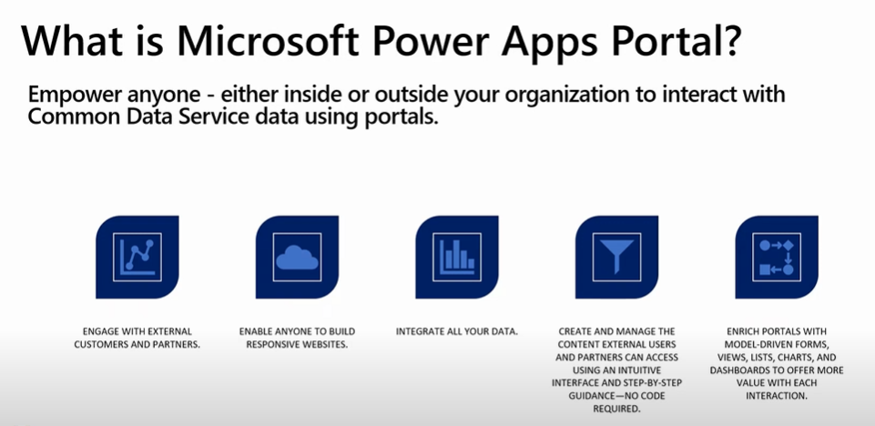

Slide 4
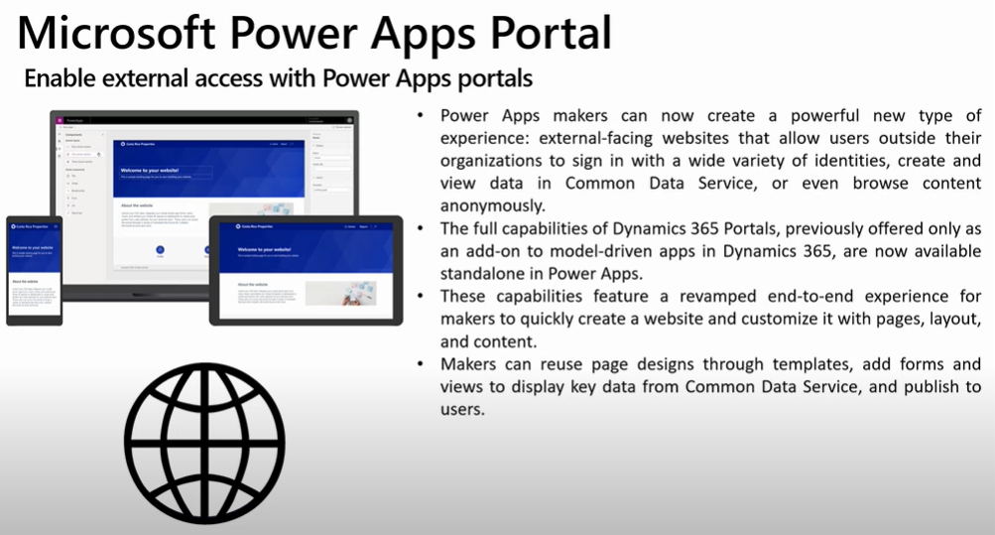

Slide 5
Portal Characteristics
A portal connects to a Dataverse environment using an Azure Active Directory application. The application is created in the same tenant where the portal is provisioned.
Each portal has a separate AAD application associated with it, whether it's connected to the same Dataverse environment or not
Authorization is enforced by web roles assigned to the user accessing the portal.
Portals created earlier than 2022 will appear as Microsoft CRM Portals.
To connect to Dataverse portal needs an authentication key which automatically gets generated and validated while provisioning a portal
Portal will bring both the flavors of Canvas and Model driven app where you can design WYSIWYG UI and have model driven structure
You can use HTML, JavaScript, CSS in portal as well
Portal uses Liquid as a programming language for customizations

Slide 6
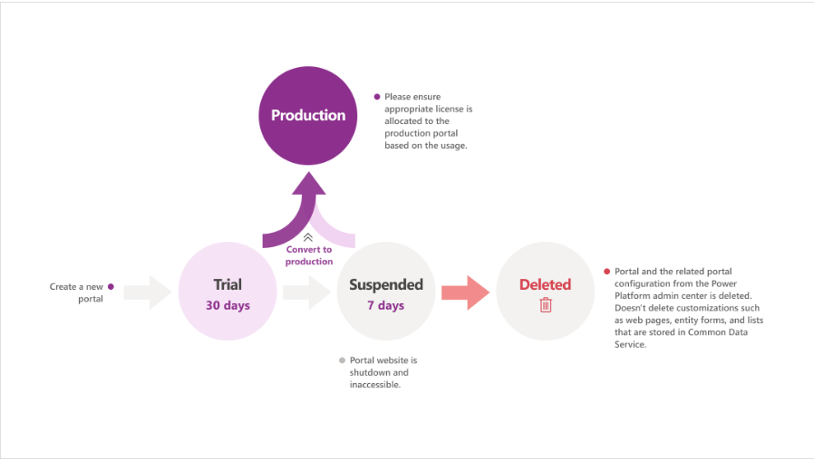
Power App Portal Life Cycle

Slide 7
Components
Section Layout
Page Templates
Themes
Text
Image
IFrame (to embed a webpage from any other website)
Form
List
Breadcrumb (shows the links to pages in the hierarchy of the current page)
Power BI
Chatbots

Slide 8
Thank You

